Slide 1
Annual Monitoring in 2023-24
Preparation of Programme Plans
3rd / 7th November 2023
Louise Ashby Deputy Head of Standards and Enhancement (Taught Provision) – Standards and Enhancement Office
Linford Butler Academic Compliance Coordinator – Standards and Enhancement Office
John Adams Management Information Report Writer – Student Data Management

Slide 2
Attention
◉ This webinar is being recorded
Today’s webinar is being recorded and may be published, in part or whole, as a supporting material for Annual Monitoring via the SEO webpages.
If you do not wish to be featured in any such recording, please ensure your camera is turned off, and submit any questions using the chat function.

Slide 3
Today’s webinar
What is the purpose of Annual Monitoring?
What is a Programme Plan?
What are the benefits of the Programme Plan?
What goes into a Programme Plan?
Preparing a Programme Plan
UNIPULSE data
Specific guidance for Off Campus Partners
Changes and updates this year
Key dates for your diary

Slide 4
The purpose of Annual Monitoring
The Programme Plan is the first building block in Annual Monitoring, providing vital data at programme level on which Subject Quality Enhancement Plans (SQEPs) and the University Quality Enhancement Plan (UQEP) can then be built
Has impact at programme level by refocussing energies to address problem areas and identify and disseminate good practice to build on successes, enhancing students’ experience and outcomes
Programme Plans feed through into Subject Quality Enhancement Plans (SQEPs), impacting planning across a set of programmes within a Subject area
Programme Plans and SQEPs both feed into the University Quality Enhancement Plan (UQEP), impacting short- and long-term planning at the institutional level
Programme Plan
Programme future planning
Local planning
Impact on students
Subject Quality Enhancement Plan (SQEP)
Subject level planning
Sub-institutional impact
Impact on students
Strategic direction
University Quality Enhancement Plan (UQEP)
Long-term planning
5 year plan and objectives
Strategy and policy
Regulatory compliance
Quality and enhancement

Slide 5
The Programme Plan
Assesses the performance of a University of Bolton programme or programme cluster
Evaluates core metrics, University KPIs and contextual information to assess performance in the academic year 2022-23
You add your analysis, evaluation and relevant context to discuss the performance, trends, direction of travel
These inform the Action Plan for the year to come, identifying good practice to be scaled and built upon, and areas for improvement to be addressed over the coming year

Slide 6
The benefits of the Programme Plan
A chance to pause, assess and refocus efforts
Reflect on what has gone well; what has improved student experience and outcomes; what has had an impact on learners – celebrate, build upon and disseminate good practice
Proactively identify new and ongoing challenges and problems – take ownership, give shape to challenges and forge a plan
Improves students’ experience and outcomes – leading to happier, more engaged students achieving better on their programme(s)
A chance to make sure the core quality issues are in hand – so you can focus on your teaching and your students

Slide 7
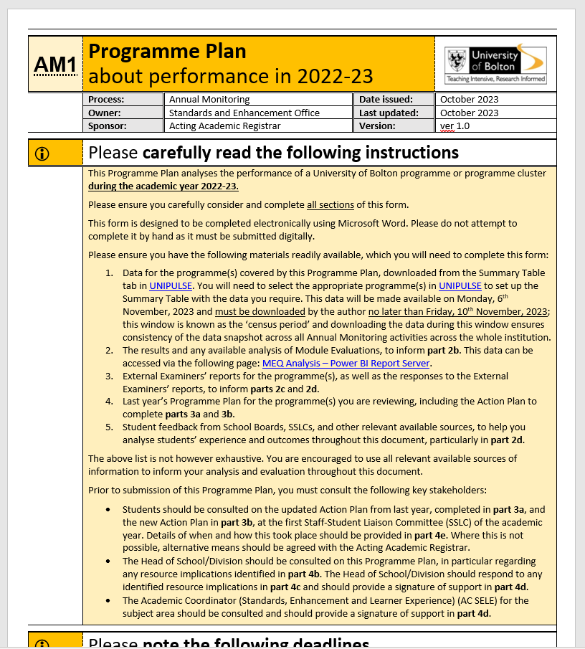
What goes into a Programme Plan
Passion for teaching and learning
Good practice/stories of success
Student feedback
Your expertise and analysis
Data from UNIPULSE
Relevant contextual info held locally
Info from last year’s Programme Plan
Module Evaluation data
External Examiner feedback
Local planning and priorities

Slide 8
Preparing your Programme Plan
Part 1 – Contextual information
Identify the programme(s) under review
Part 2 – Programme analysis
Review core data for the programmes
Review the outcomes of module evaluation;
Review External Examiners’ comments on academic standards
Evaluate teaching quality, student experience and support, and employability on the programme(s)
Part 3 – Action planning
Review and update the previous year’s Action Plan
Prepare a new Action Plan for the coming year, including outstanding actions from last year, areas for improvement in the coming year, and features of good practice to be built upon
Students should be consulted on the Action Plans at SSLC before submission
Part 4 – Future planning and sign-off
Assess future opportunities and risks to determine the future direction of the programme(s)
Assess resource implications
Demonstrate AC SELE and Head of School/Division support
Details of student consultation

Slide 9
UNIPULSE data
Programme Plans review key University performance data which help to analyse performance year-on-year
These metrics are aligned with standard measures used across the HE sector and by regulatory bodies such as the Office for Students
Some data comes from the National Student Survey – ‘teaching on my course’, ‘assessment and feedback’, ‘academic support’, course continuation, course completion, and progression
Some are University KPIs, set by the University as goals for improvement – applications, enrolments, conversions, attendance, average module mark, modules passed first time, achievement of ‘good honours’
Data is held in UNIPULSE – we will demonstrate how to access and explore the data later in this session

Slide 10
Off Campus partners
For off campus programmes, the partner Course Manager normally complete the Programme Plan(s), supported by the Link Tutor (LT)
If your programme is brand new for this academic year, you won’t need to produce a Programme Plan this year, but you will need to in 2024-25
Data for off campus programmes is not stored in UNIPULSE; these are instead published in partner data reports which will be provided via the Partnership Management teams
We recognise that different partners have different intake points; the data provided in the data reports takes account of this

Slide 11
Developments
The Programme Plan forms have been redesigned and clarified – questions are clearer, more direct and more specific; and the forms make it easier to input data
We continue to review the process to make it clearer and easier for authors to complete
We are exploring innovations, including digitised approaches to the Annual Monitoring process for future years

Slide 12
Key dates for your diary
Census date for publication of data for Programme Plans and SQEPs:
Monday, 6th November, 2023
Census period (during which data should be downloaded):
Monday, 6th – Friday 10th November, 2023
Deadline for submission of Programme Plans:
Monday, 4th December, 2023
Further information on deadlines for other elements of the process, e.g. SQEPs, can be found in the Annual Monitoring Guidelines via the SEO webpages

Slide 13
Supporting materials
Guidance materials to support you throughout the Annual Monitoring process can be found via the SEO website at:
tinyurl.com/UoBAM
(short link forwards automatically to https://hub.bolton.ac.uk/Quality/RM/AnnualMonitoring/Home.aspx)
This includes:
Annual Monitoring Guidelines 2023-24 – contains all details!
Programme Plan template (form AM1)
SQEP template (form AM2)
Partnership Oversight and Development Handbook 2023-24
Best Practice Curriculum Guide
UNIPULSE How To Guide

Slide 14
Thank you
There will now be a live demonstration showing you how to access and explore data in UNIPULSE, followed by a Q&A

